Slide 1
Section 1.3 Multiplying Two Digit Numbers
© Copyright all rights reserved to Homework depot: www.BCMath.ca

Slide 2
Traditional Method:
The traditional method for multiplying:
© Copyright all rights reserved to Homework depot: www.BCMath.ca

Slide 3
Review:
The product of two numbers can be represented by the area of a rectangle
Each number is either the length or width of the rectangle
The bigger number can be the length and the smaller is the width
The number of unit squares is the area of the area
© Copyright all rights reserved to Homework depot: www.BCMath.ca

Slide 4
Multiplying Two Digit Integers with Area Model:
Split each number as the sum of a multiple of 10 with a single digit
ie: 23 = 20 + 3 , 46 = 40 + 6 , 117 = 110 + 7
Split the rectangle into four parts so that the area of each one is easier to count
The product will be the sum of the area of all four rectangles
© Copyright all rights reserved to Homework depot: www.BCMath.ca

Slide 5
Practice: Find the area of each product using the area model
Split each number as the sum of two digits
© Copyright all rights reserved to Homework depot: www.BCMath.ca

Slide 6
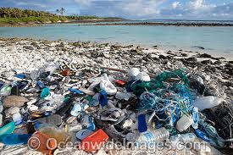
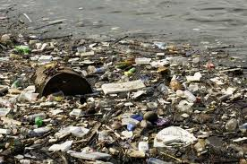
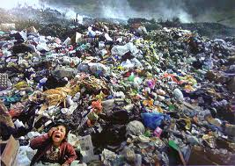
Garbage Management:
An average Canadian creates 2200g of garbage each day. If the population of Canada is 34,000,000 how many pound of garbage will there be in a day? week?
© Copyright all rights reserved to Homework depot: www.BCMath.ca

Slide 7
In a day:
In a week:
© Copyright all rights reserved to Homework depot: www.BCMath.ca

Slide 8
Homework:
© Copyright all rights reserved to Homework depot: www.BCMath.ca

